Slide 1

The Machine Learning Process
When should I use a "groupby"
in pandas?
Dr. Reza Dibaj

Slide 2
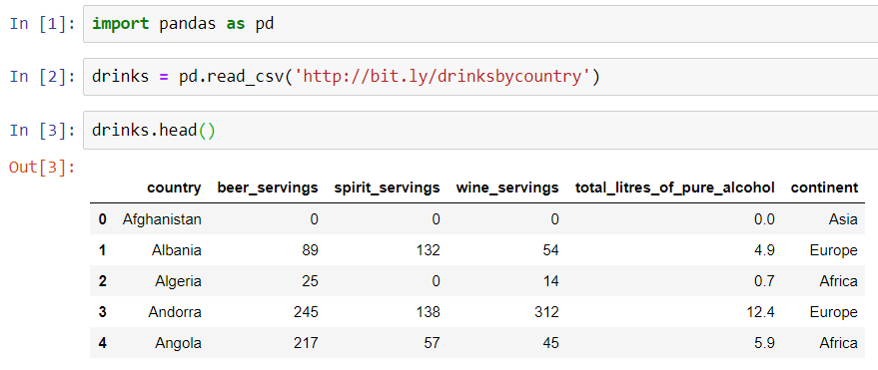
When should I use a "groupby" in pandas?
Let’s pull up an example dataset as follows:
Notes:
import pandas as pd
drinks = pd.read_csv('http://bit.ly/drinksbycountry’)
drinks.head()

Slide 3
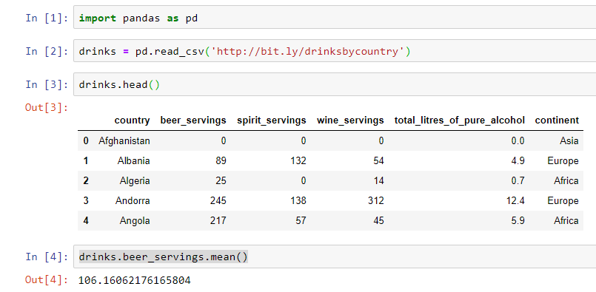
When should I use a "groupby" in pandas?
What is the average beer servings across all countries?
Notes:
drinks.beer_servings.mean()

Slide 4
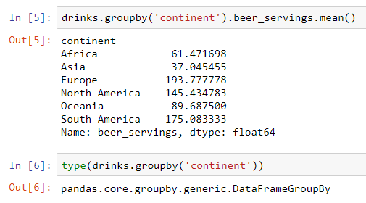
When should I use a "groupby" in pandas?
What if we want to look at the average of beer servings by continent?
Notes:
drinks.groupby('continent').beer_servings.mean()
type(drinks.groupby('continent'))

Slide 5
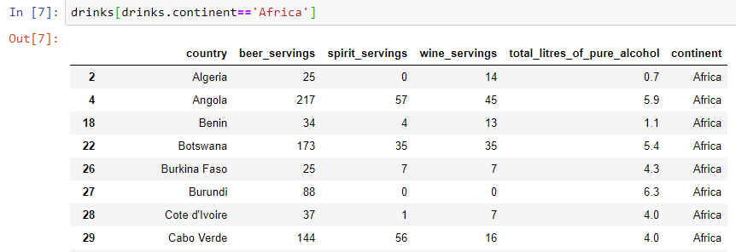


When should I use a "groupby" in pandas?
How does this “groupby” actually work?
Notes:
drinks[drinks.continent=='Africa’]
drinks[drinks.continent=='Africa'].beer_servings.mean()

Slide 6

Group Discussion
Please spend a few minutes with your team members and explain in when do we need to use the “groupby” concept?
Notes:
Rephrasing groupby by for each and it totally makes sence.

Slide 7
Group Discussion
Please spend a few minutes with your team members and find some other aggregate functions apart from mean()….
Notes:
Rephrasing groupby by for each and it totally makes sence.

Slide 8
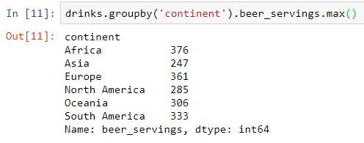
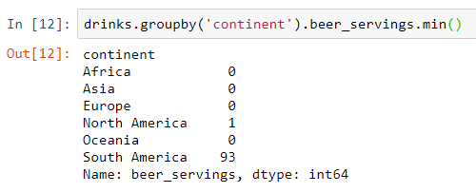

When should I use a "groupby" in pandas?
A few more aggregate function….
Notes:
drinks.groupby('continent').beer_servings.max()
drinks.groupby('continent').beer_servings.min()
drinks.groupby('continent').beer_servings.std()

Slide 9
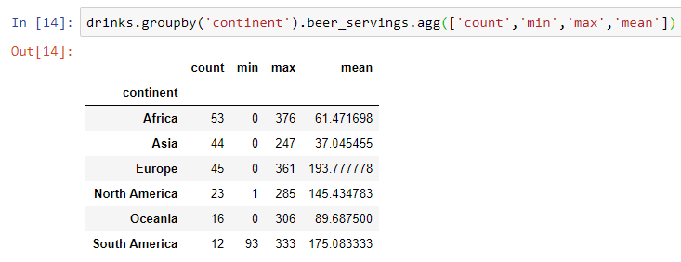
When should I use a "groupby" in pandas?
What if we want to run a few aggregation functions in one line…
Notes:
drinks.groupby('continent').beer_servings.agg(['count','min','max','mean'])

Slide 10

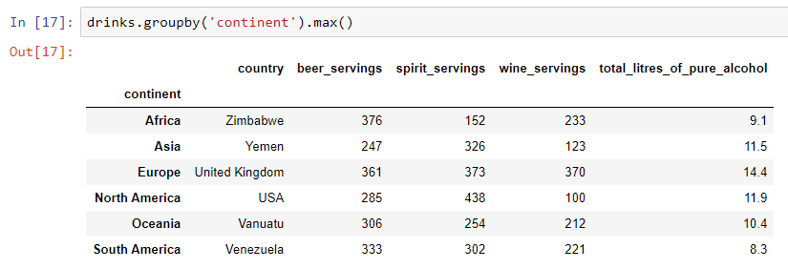
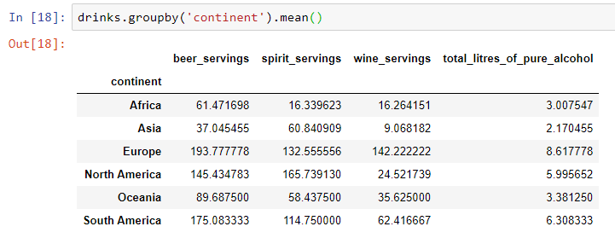
Bonus Tip
By writing a groupby we do not have to specify a column, and it applies it across all numeric columns….
Notes:
drinks.groupby('continent’).max()
drinks.groupby('continent').mean()

Slide 11
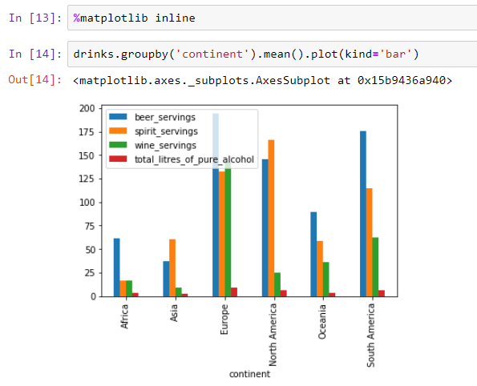
Bonus Tip
Let’s add more spice to it... Visualization!
Notes:
%matplotlib inline
drinks.groupby('continent').mean().plot(kind='bar')

Slide 12

Thank you
Question?
To be
Not to be

